Slide 1





IMPLEMENTATION OF AVL TREES
Dr.Priyanka N
Assistant Professor Senior Grade 1
School of Computer Science & Engineering VIT,Vellore.

Slide 2

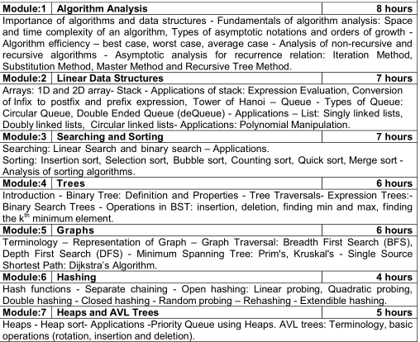

Slide 3


AVL Trees
AVL tree is a height-balanced binary search tree
It is also a binary search tree but it is a balanced tree.
What is Balanced Tree?
A binary tree is said to be balanced if, the difference between the heights of left and right subtrees of every node in the tree is either -1, 0 or +1
In an AVL tree, every node maintains an extra information known as balance factor

Slide 4


Construction of AVL Tree (1 to 8)
Example:
BF=-1
4
BF=0
BF=-1
2
6
BF=0
BF=0
BF=0
5
BF=-1
1
7
3
BF=0
8
TREE is balanced

Slide 5


Node Structure
Struct Node
{
int data;
struct Node *left; struct Node *right; int height;
};
LEFT | DATA | RIGHT | HEIGHT
NODE

Slide 6

Height of the Node
height(Struct Node *Node)
{
if(Node==NULL)
return 0;
return Node->Height;
}
LEFT | DATA | RIGHT | HEIGHT
NODE

Slide 7


Creation of Node
Create newNode(int value)
{
Struct Node *newnode;
newnode= malloc(sizeof(Struct node); newnode->data=value;
newnode->left=NULL; newnode->right=NULL; newnode->height=1;
return newNode;
}
NULL | 10 | NULL | 1
newNODE

Slide 8


Balance Factor of the Node
Balance Factor(Struct Node *Node)
{
if(Node==NULL)
return 0;
return height(Node->left)-height(Node->right) ;
}
LEFT | DATA | RIGHT | HEIGHT
NODE

Slide 9


Left Rotate
Struct Node *Left Rotate( Struct node *x)
{
Struct Node *y= x->right; Struct Node *T= y->left;
y->left =x;
x->right=T;
x->height= max(height(x->left), height(x->right))+1;
y->height=max(height(y->left),height(y->right))+1; return y;
}
y
x
5
7
y
8
7
5
x
6
8
6
T
T

Slide 10


Right Rotate
Struct Node *Right Rotate( Struct node *y)
{
Struct Node *x= y->left; Struct Node *T= x->right; x->right=y;
y->left =T;
x->height= max(height(x->left), height(x->right))+1; y->height= max(height(y->left), height(y->right))+1; return x;
}
y
x
5
3
x
y
3
2
5
2
4
4
T
T

Slide 11


Finding Max
Max( a,b)
{
return(a>b)? a:b;
}
//Returns which is maximum among a and b

Slide 12


Insertion Operation
Node and value to be inserted is passed every time
insert(struct * node, int value)
{
if(node == NULL)
return newNode(value); if(value < node->data)
{
node->left = insert(node- >left, value);
else if(value > node->data)
node->right =insert(node->right, value);
else
return node
}
// founds the correct position and inserts node

Slide 13
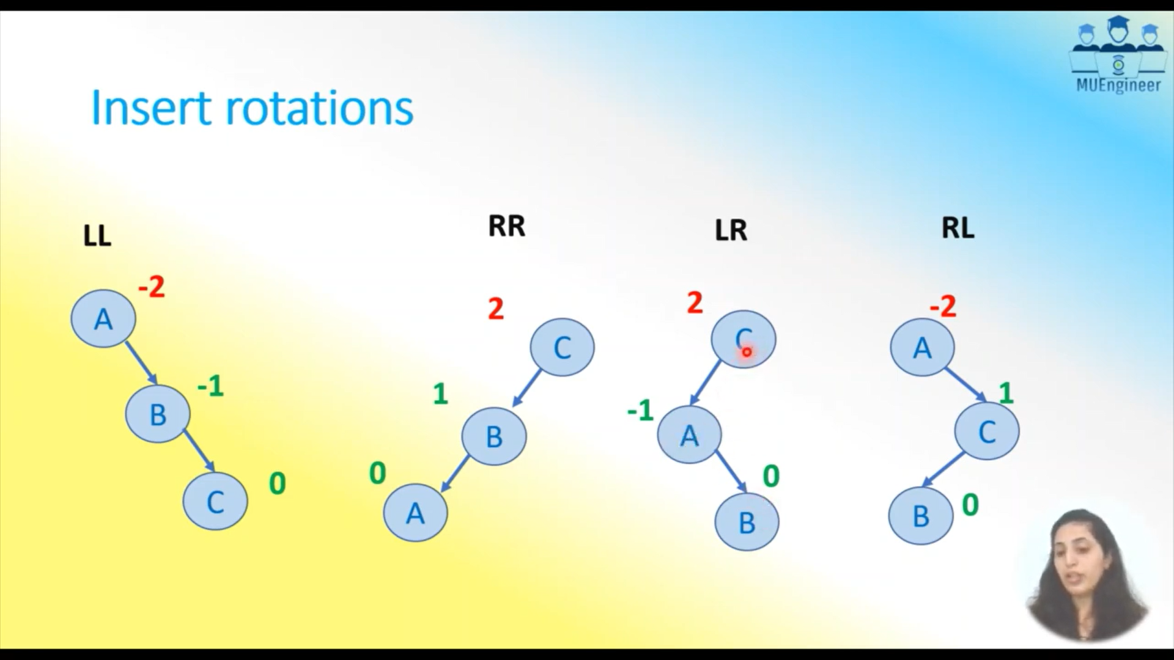
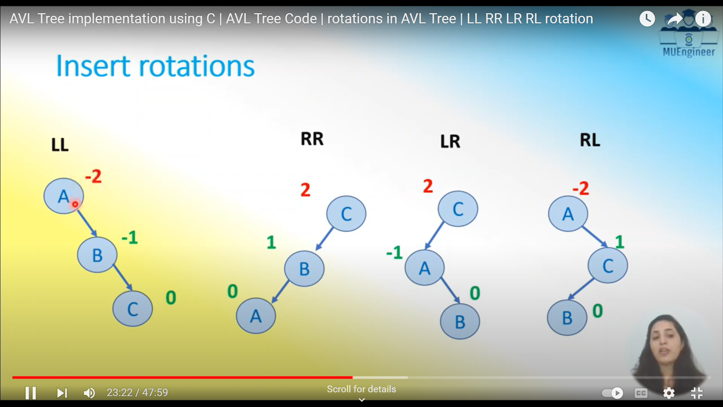
ROTATIONS

Slide 14


Insertion Operation
// Update the height & Balance Factor of each node
Node->height =max[height(node->left), height(node->right)]+1;
Balance = Balance Factor(node);
// ROTATIONS
if(balance>1 && value<node->left->value)// RR Rotation return rightrotate(node);
if(balance <-1&& value>node->right->value)// LL Rotation
return leftrotate(node);
if(balance >1&& value>node->left->value)// LR Rotation node->left= leftrotate(node->left);
return rightrotate(node);
if(balance <-1&& value<node->right->value)// RL Rotation
node->right= rightrotate(node->right); return leftrotate(node);
return node;
}

Slide 15

deleteNode(struct node* root, int value)
{
if (root == NULL) // value not found return root;
// key less than value of root then it lies in left subtree if (value< root->data)
root->left = deleteNode(root->left, value);
// key greater than value of root then it lies in right subtree else if (value > root->data)
root->right = deleteNode(root->right, value);
// key is same as value of root, node be deleted is found else
{

Slide 16

// node with only one child or no child
if (root->left == NULL)
{
struct node* temp = root->right; free(root);
return temp;
}
else if (root->right == NULL)
{
struct node* temp = root->left; free(root);
return temp;
}

Slide 17
// node with two children, Get smallest in the right subtree)
struct node* temp = minValueNode(root->right); root->value = temp->value;
// Delete the node
root->right = deleteNode(root->right, temp->value);
}
return root;
}
// Update the height & Balance Factor of each node

Slide 18

Balance = Balance Factor(root);
root->height =max[height(root->left), height(root->right)]+1;
// ROTATIONS
if(balance>1 && value<root->left->value)// RR Rotation
return rightrotate(root);
if(balance <-1&& value>root->right->value)// LL Rotation return leftrotate(root);
if(balance >1&& value>root->left->value)// LR Rotation
root->left= leftrotate(rotate->left);
return rightrotate(root);
if(balance <-1&& value<root->right->value)// RL Rotation root->right= rightrotate(root->right);
return leftrotate(root);
return root;
}

